Slide 1
Lecture 39:
Peptides
Oligonucleotides

Slide 2

CHM 257
7:30-8:30 PM WTHR 360
6:30-7:30 WTHR 360
SUPPLEMENTAL INSTRUCTION
Friday 11:30-12:30 PM KRCH 431

Slide 3
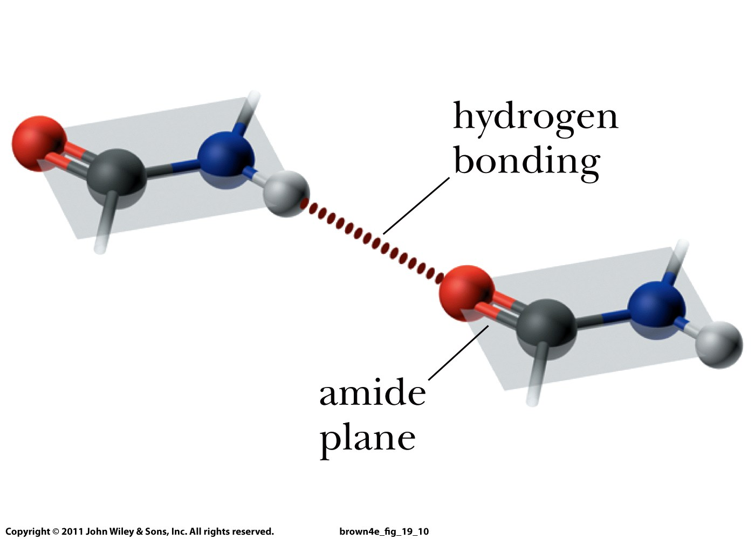

Slide 4
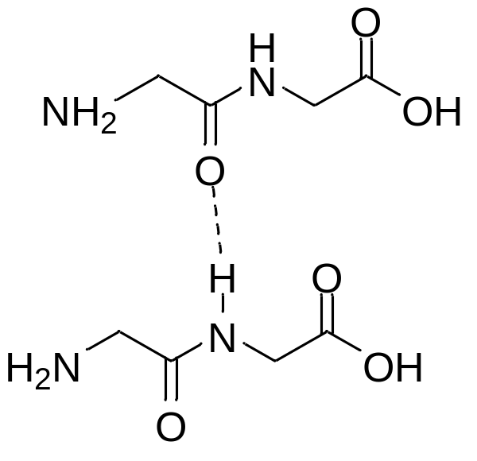
Buddy Question # 139
Show two dipeptides that are hydogen-bonded
to each other

Slide 5
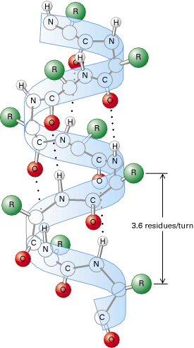
An α-Helix

Slide 6
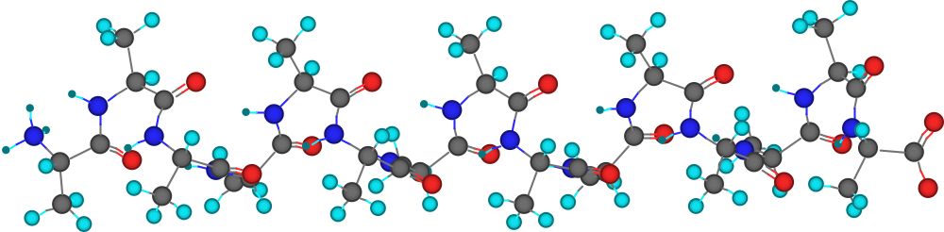
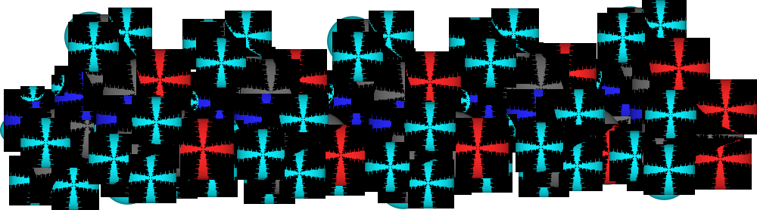
An α-Helix
Polyalanine, cylindrical bonds model, viewed along its length. Sites of H-bonding are visible.

Slide 7
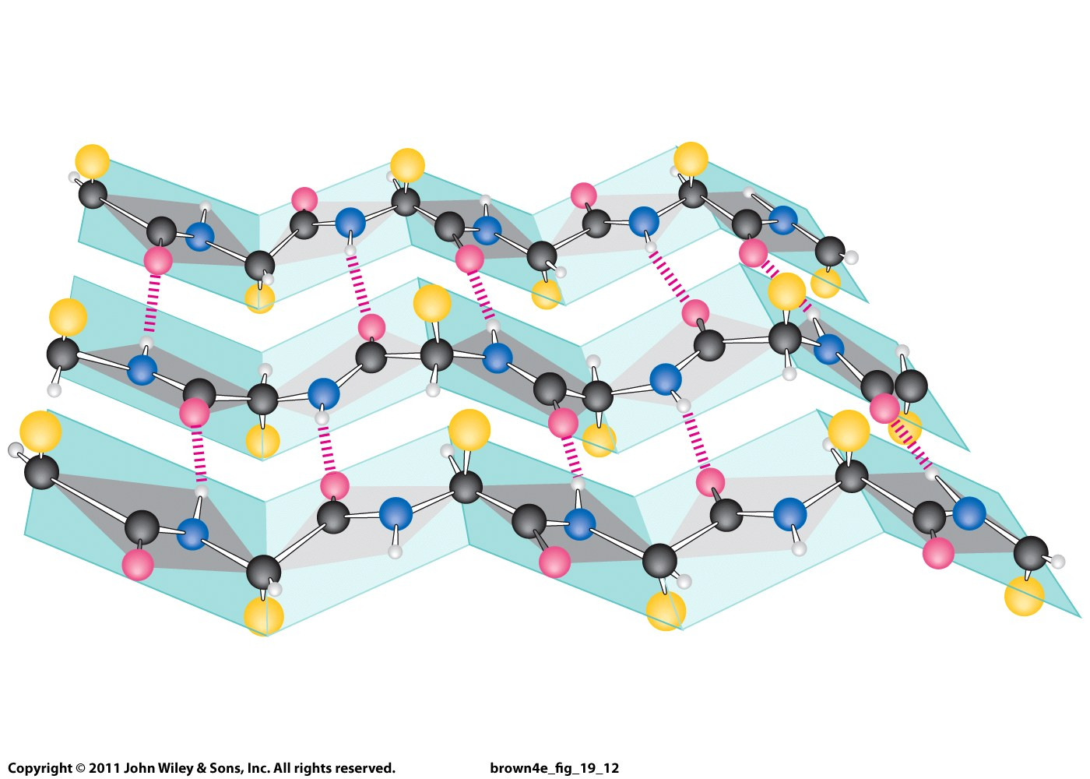
β-Pleated sheet conformation with three polypeptide chains running in opposite directions.

Slide 8
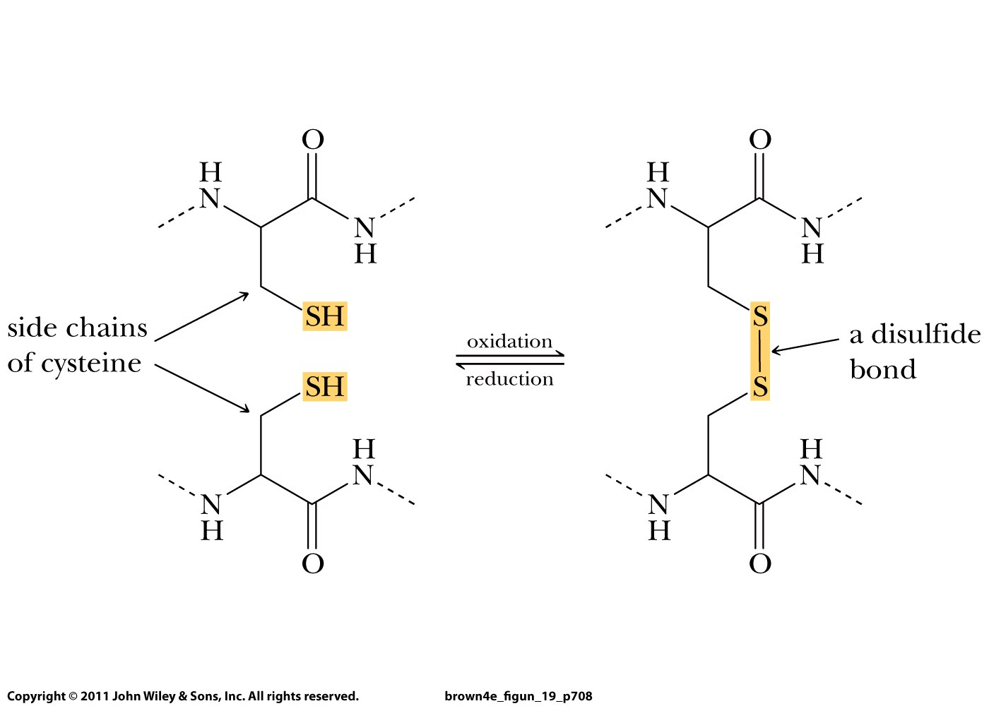

Slide 9
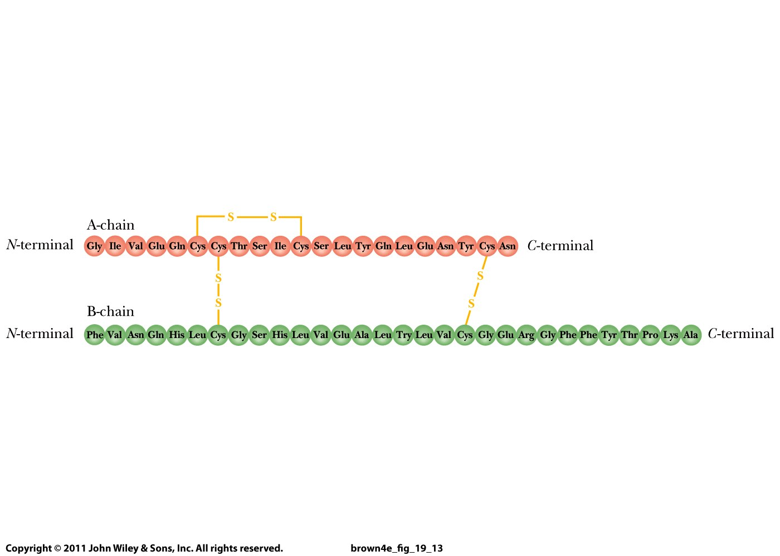
Internal disulfide bond
Intramolecular disulfide bonds

Slide 10
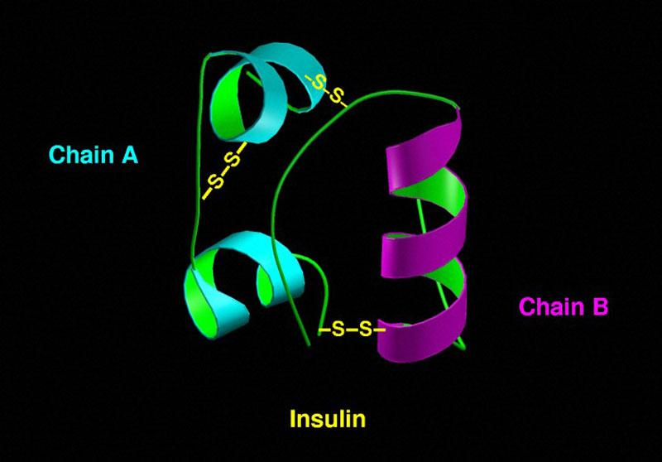

Slide 11
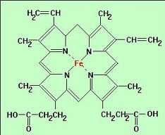
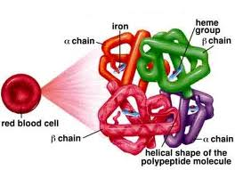
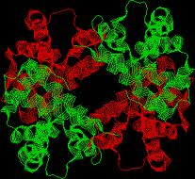
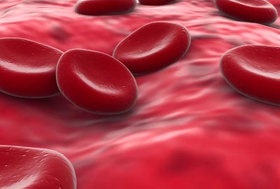
  Hemoglobin consists of two α chains and two β chains.

Slide 12
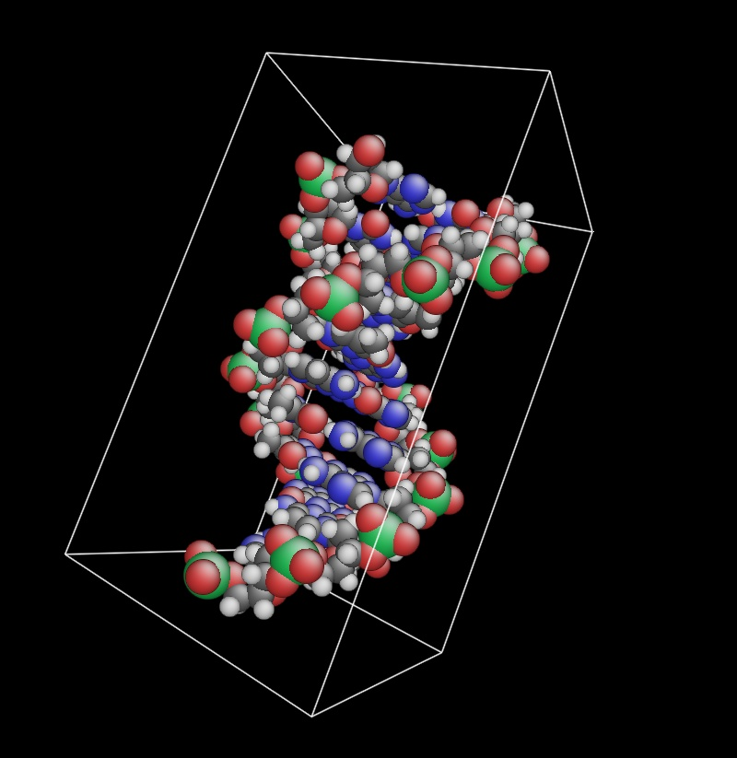
DNA

Slide 13
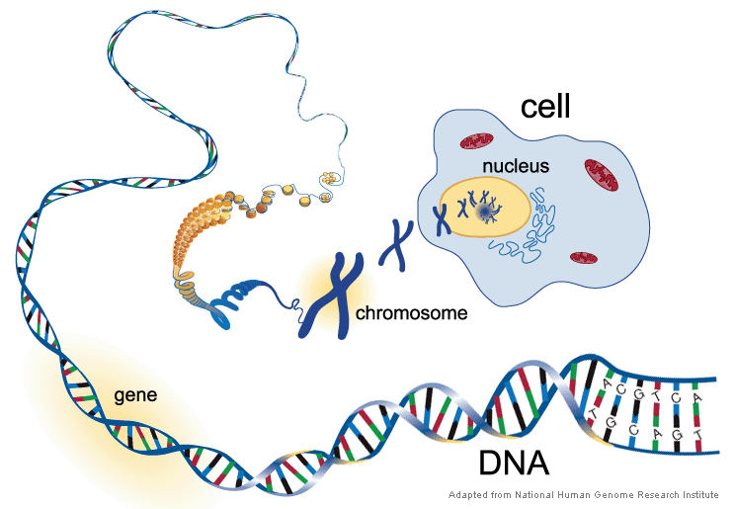

Slide 14
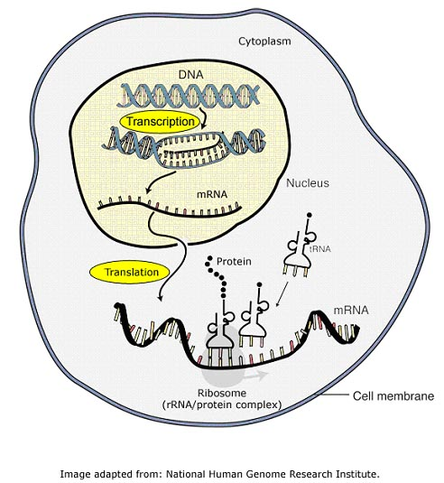

Slide 15
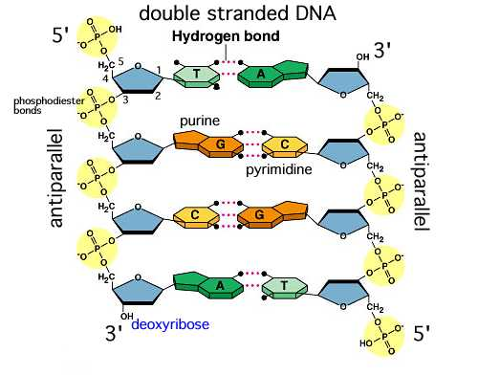

Slide 16
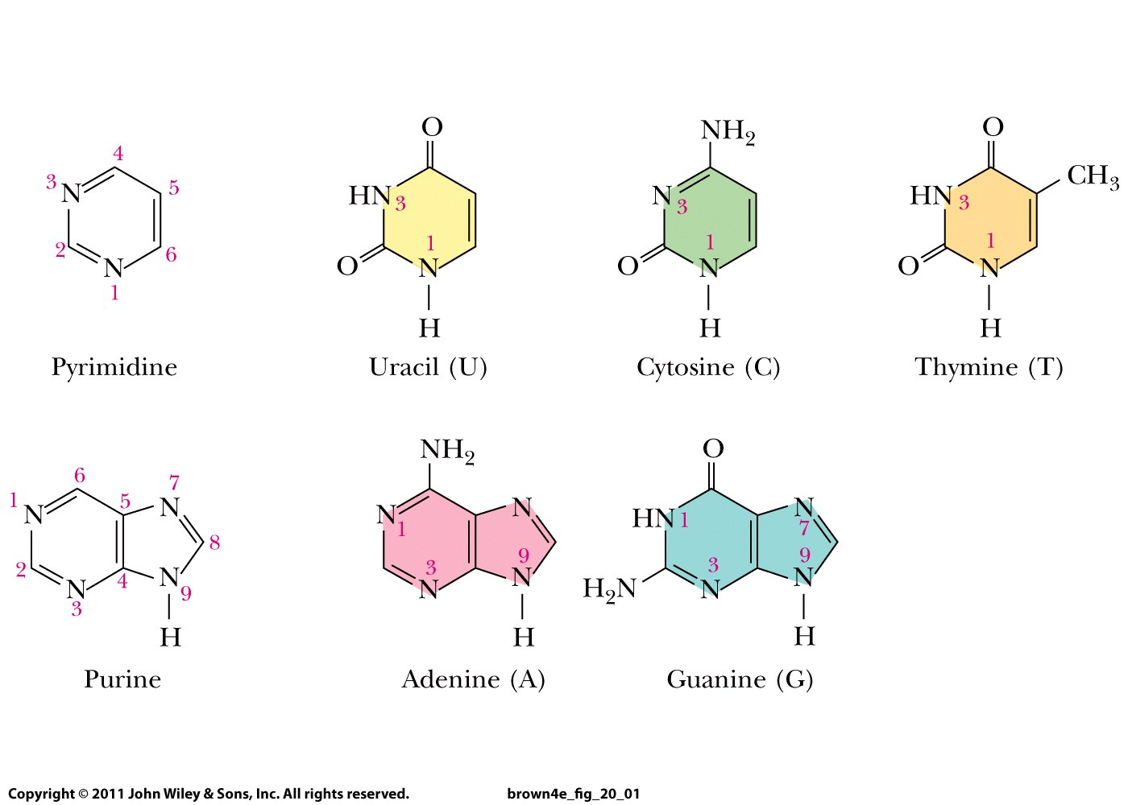

Slide 17
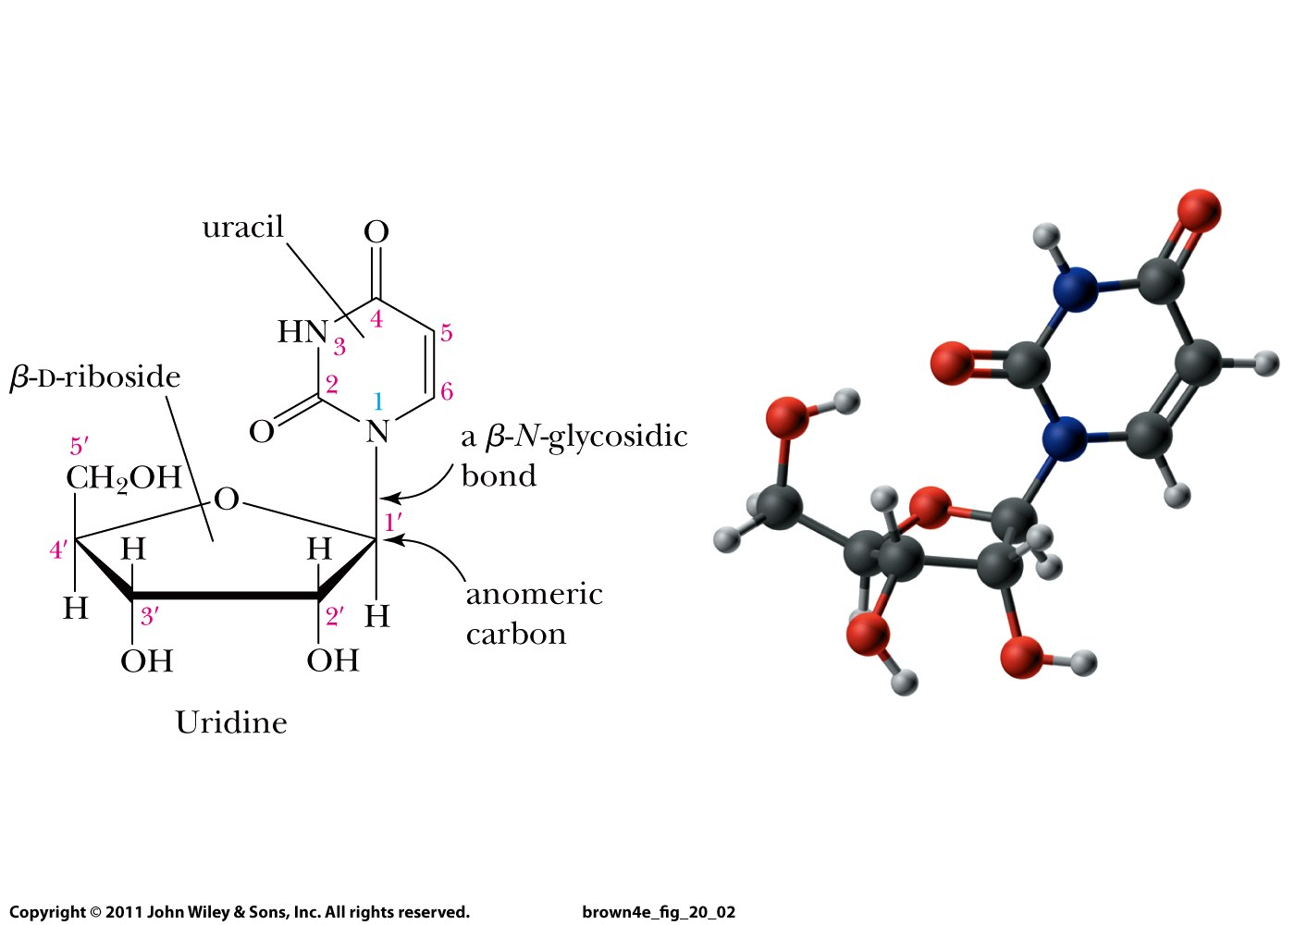
Nucleoside
Uridine (Adenosine, Cytidine, Thymidine, Guanosine)

Slide 18
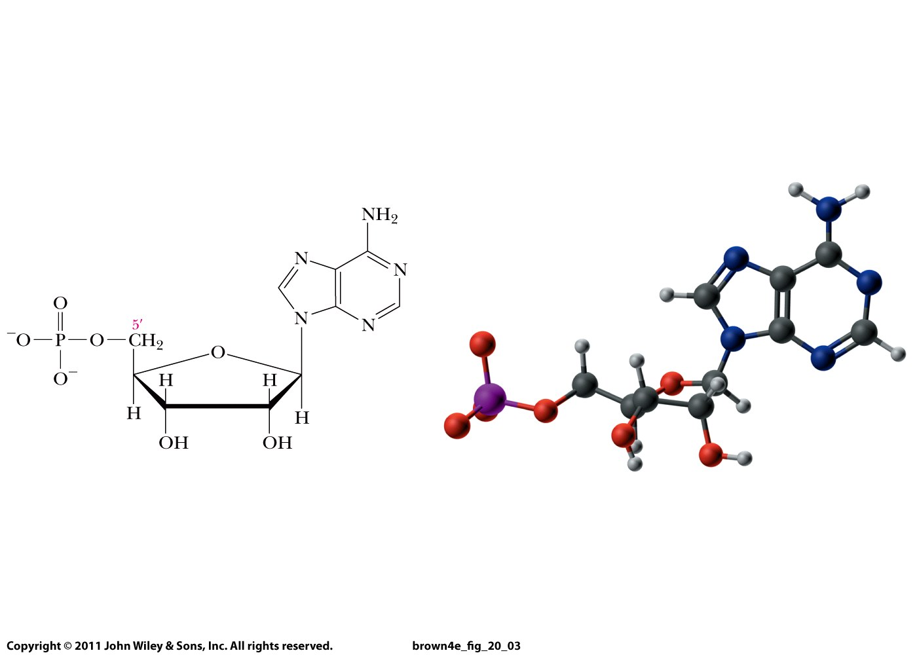
Nucleotide
Adenine
Adenosine
Adenosine 5’-monophosphate

Slide 19
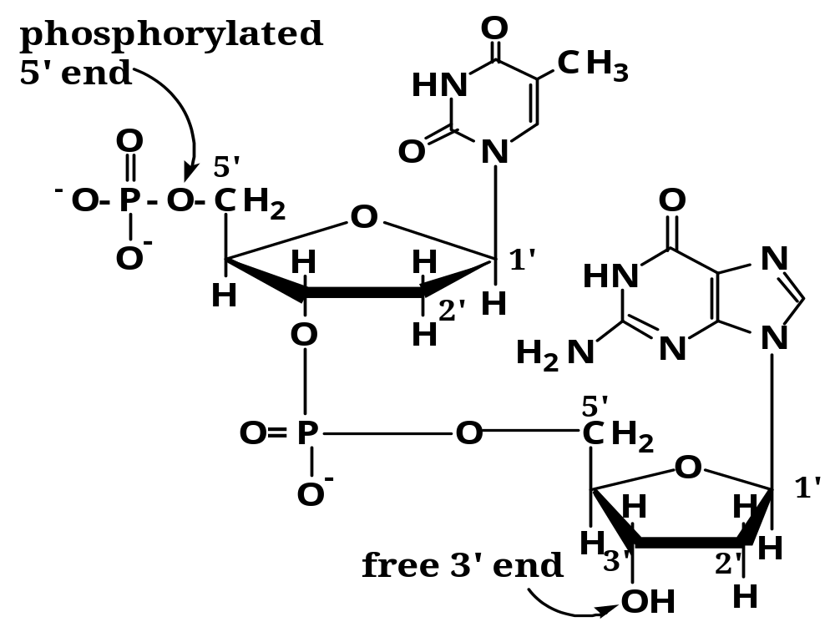
DNA = deoxyribonucleic acid
Thymine = T
Guanine = G
Sequence: TG
DNA: 2’ OH missing

Slide 20
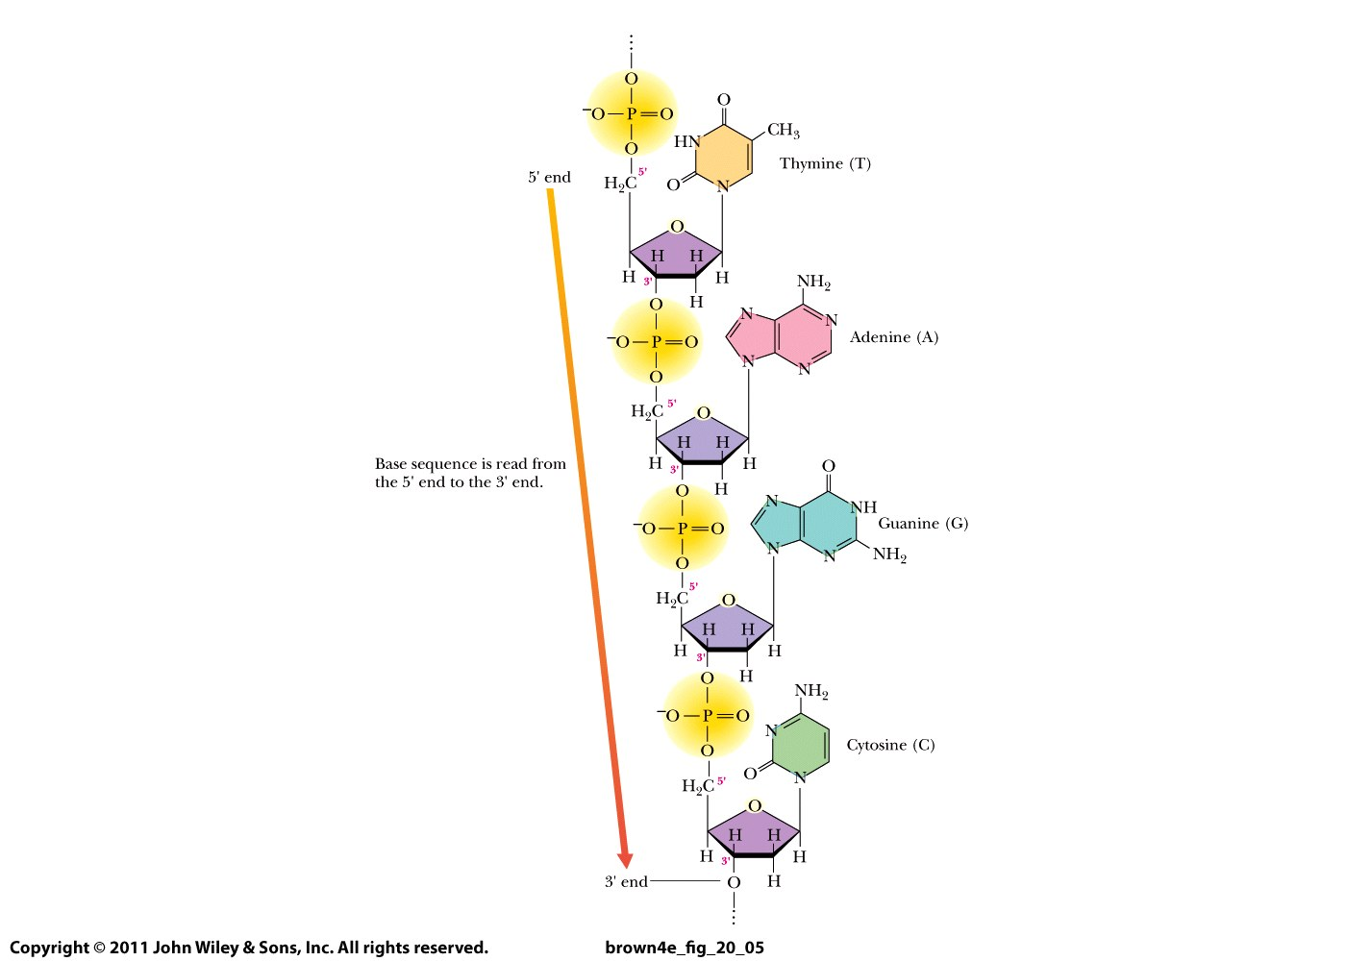

Slide 21
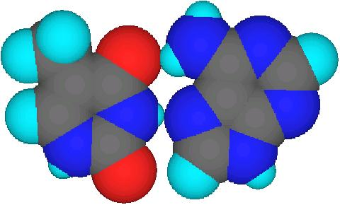
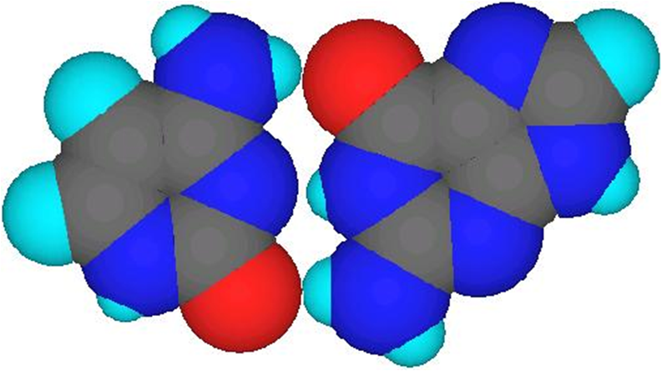
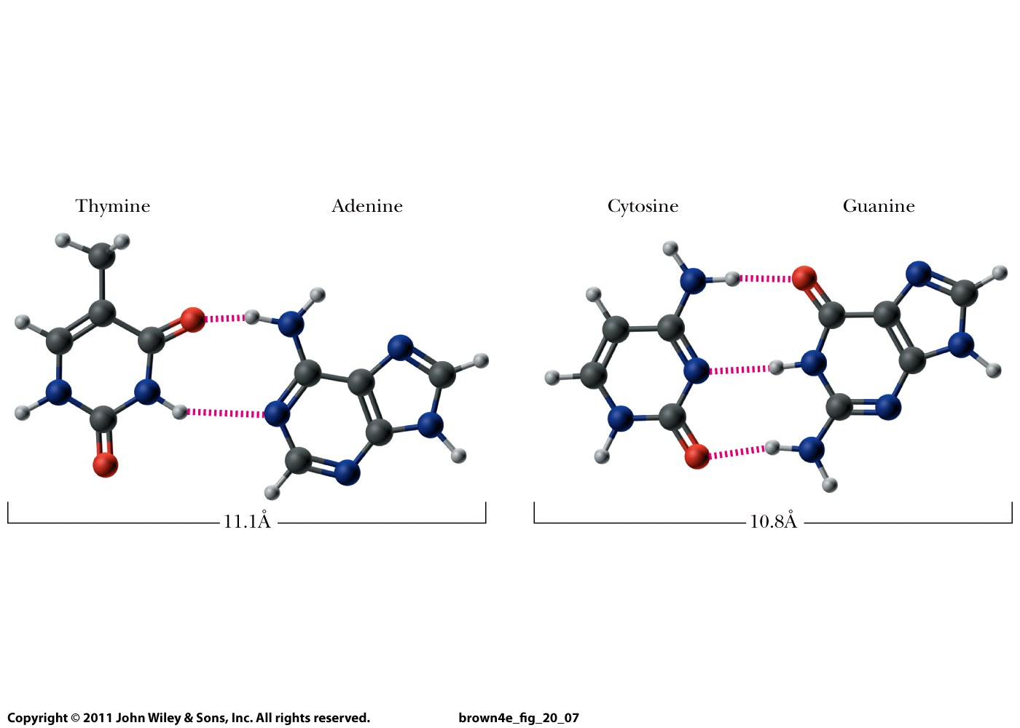

Slide 22
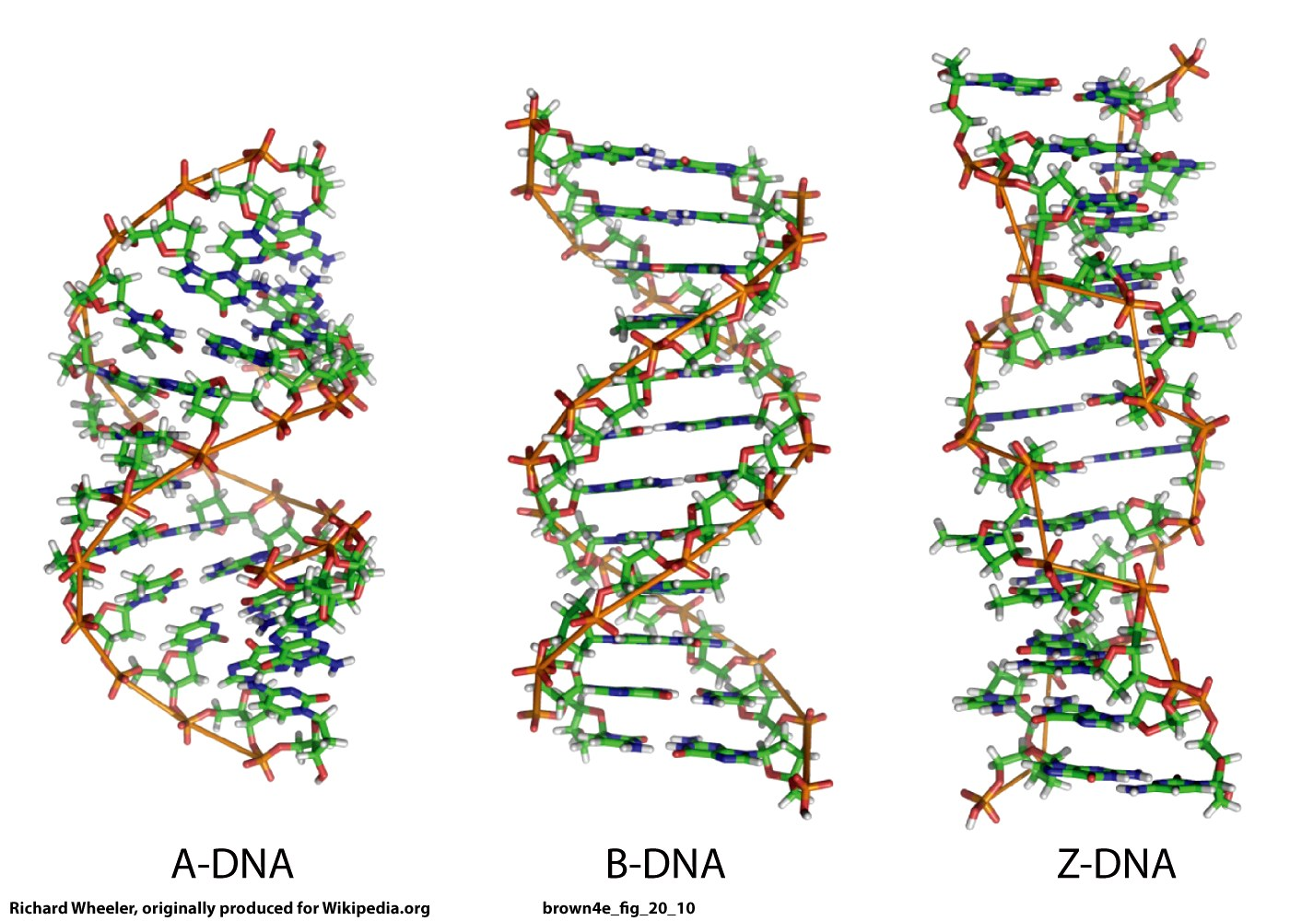

Slide 23
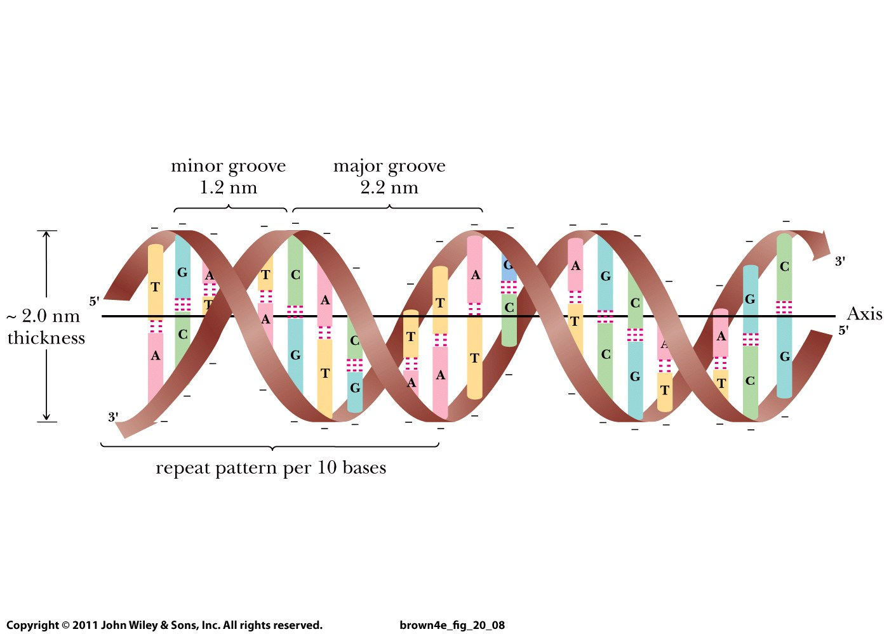

Slide 24
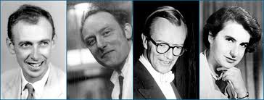
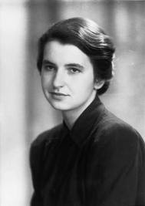
Nobel Prize in Physiology or Medicine in 1962:
Watson Crick Wilkins
Rosalind Franklin
1920 - 1958
(37 years old)

Slide 25
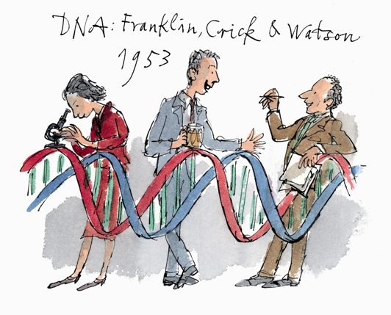
Quentin Blake

Slide 27
